Slide 1
AIDI 1010 – Introduction to Emerging Technologies WEEK6
Jahanzeb Abbas (JB)

Slide 2
Week Objectives
(A) HyperOpt & HyperOpt-sklearn
What is it?
(B) HyperOpt-sklearn
Pros/Cons
Hyperparameters
(C) Examples
(D) References

Slide 3
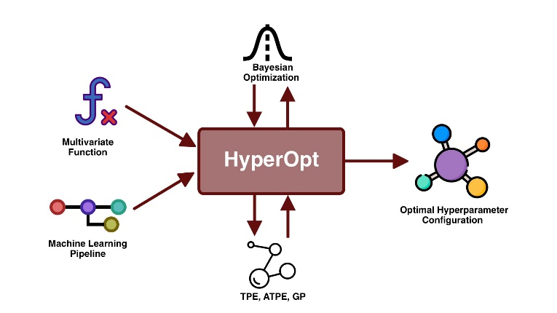
(A) HyperOpt (What is it?)
HyperOpt = Distributed Asynchronous Hyperparameter Optimization; an open-source Python library enabling AutoML
HyperOpt was made by James Bergstra, et al. in 2011; a tool that allows automation of the search for optimal hyperparameters for any ML model being used
HyperOpt is based on Bayesian Optimization supported by a SMBO methodology - which can work with optimization algorithms like Gaussian Processes (GP), Tree of Parzen Estimators (TPE), Adaptive Tree of Parzen Estimators (ATPE)
HyperOpt requires four components for optimization of hyperparameters
Search Space
Loss Function
Optimization Algorithm
Database (for scoring history, score, configuration)
HyperOpt is difficult to use directly, since optimization procedures and search spaces are to be carefully crafted and monitored
All documentation is available on:
https://github.com/hyperopt /// https://github.com/hyperopt/hyperopt/wiki
https://hyperopt.github.io/hyperopt/
https://miro.medium.com/max/2000/1*2gsysrNnSD-n8HDCHmpZFw.jpeg

Slide 4


TANGENT: HyperOpt – Details (1)
Hyperparameter vs Model Parameters
Formula is representing Hyperparameter Optimization; find the model hyperparameters that yield the best score on a validation set metric
Hyperparameters usually set by ML Engineers prior to training
Example: # of trees in a Random Forest = Hyperparameter (model settings)
Example: Weights in a neural network = Model Parameters learned during training
Bayesian Optimization
A hyperparameter optimization strategy; a technique that chooses the best hyperparameter through earlier bias/beliefs
Build a probability model of the objective function and use it to select the most promising hyperparameters to evaluate in the true objective function.
Picks a prior belief on how the hyperparameters will behave, and searches the parameter space by enforcing/updating that prior belief during training; prior beliefs influencing predictions; https://youtu.be/ttE0F7fghfk
SMBO = Sequential Model-Based Global Optimization
Formalization of Bayesian Optimization and in some ways – more efficient than Bayesian
Iterates between fitting models and using them to make choices about which configurations to investigate
Reduces running time of hyperparameter tuning, conducts better scores on testing set in the same # of trials as other estimators (like Random Search)
https://miro.medium.com/max/780/1*QR4_VOfAAWLVe2I0nqwtTg.png

Slide 5
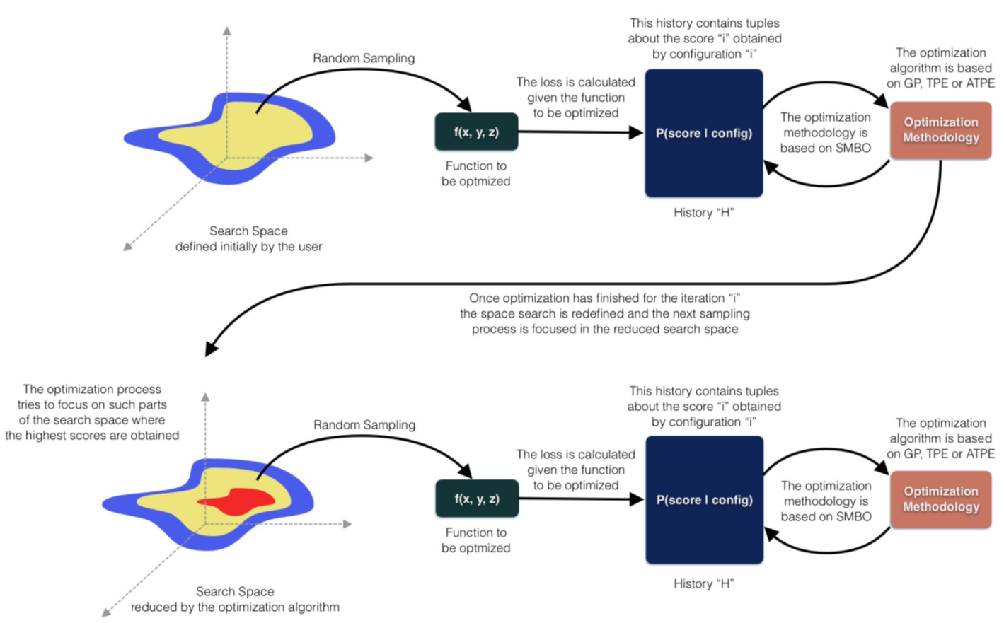
TANGENT: HyperOpt – Details (2)
Four Components: Search Space, Loss Function, History, Optimization Algorithm
https://miro.medium.com/max/2000/1*2gsysrNnSD-n8HDCHmpZFw.jpeg

Slide 6

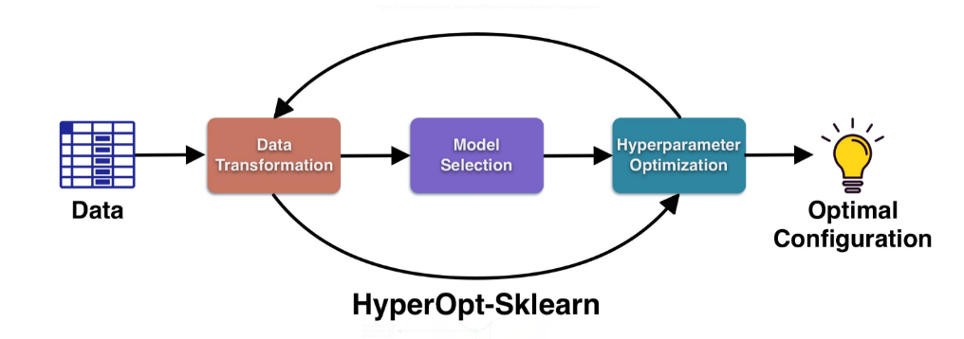
(A) HyperOpt-sklearn (What is it?)
HyperOpt-sklearn = aka hpsklearn, is a library introduced in 2014, an extension of HyperOpt; built on top of HyperOpt – hpsklearn is designed to work with various components of scikit-learn
It can help optimize ML pipelines while addressing the data transformation, model selection, and hyperparameter optimization phases
It requires three essential parameters (customizable):
The type of data preprocessor
performs assessment, cleaning, transformation, reduction
The machine learning model (classifier or regressor)
The optimizer
It can be used for classification and regression implementations
It has (so far) 24 classifiers, 12 regressors, and 9 preprocessing methods
https://pythonrepo.com/repo/hyperopt-hyperopt-sklearn-python-deep-learning
https://miro.medium.com/max/2000/1*2gsysrNnSD-n8HDCHmpZFw.jpeg

Slide 7
(B) HyperOpt-sklearn: Pros/Cons
PROS | CONS
Designed for large scale datasets and to be used with multiple cores/machines | Applicable to classifiers/regressors only
Explicitly used to optimize ML pipelines | Different Models for same dataset
Easy Install & Fast Performance | Simple & Limited Documentation

Slide 8
(B) HyperOpt-sklearn: Hyperparameters
HyperOpt Estimator (Class)
Parameter name | Default value | Description
algo | - | Algorithm used for the search; hyperopt suggest algo (e.g. rand.suggest)
max_evals | - | Int; Number of evaluations performed in the search; Fit() will evaluate up to this-many configurations. Does not apply to fit_iter, which continues to search indefinitely.
trial_timeout | - | Float (seconds); Limit imposed on evaluating each pipeline; None for no timeout; Kill trial evaluations after this many seconds.
classifier | - | Used for classification tasks, specifies the classification search of models; ; use the value: any_classifier(‘cla’)
regressor | - | Used for regressor tasks, specifies the regression search of models; use the value: any_regressor(‘reg’)
preprocessing | None | Used to perform data preparation operations; should use the value: any_preprocessing to use a pre-defined list; default is None; This should evaluate to a list of sklearn-style preprocessing; modules (may include hyperparameters). When None, a random preprocessing module will be used.
ex_preprocs | None | Default is None; This should evaluate to a list of lists of sklearn-style preprocessing modules for each exogenous dataset. When None, no preprocessing will be applied to exogenous data.
loss_fn | - | A function that takes the arguments (y_target, y_prediction) and computes a loss value to be minimized. If no function is specified, '1.0 - accuracy_score(y_target, y_prediction)' is used for classification and '1.0 - r2_score(y_target, y_prediction)‘ is used for regression
continuous_loss_fn | False | Boolean; default is False; When true, the loss function is passed the output of predict_proba() as the second argument. This is to facilitate the use of continuous loss functions like cross entropy or AUC. When false, the loss function is given the output of predict(). If true, `classifier` and `loss_fn` must also be specified.
fit_increment | - | Int; Every this-many trials will be a synchronization barrier for ongoing trials, and the hyperopt Trials object may be check-pointed. (Currently evaluations are done serially, but that might easily change in future to allow e.g. MongoTrials)
fit_increment_dump_filename | - | Str or None; Periodically dump self.trials to this file (via cPickle) during fit() Saves after every `fit_increment` trial evaluations.
seed | None | numpy.random.RandomState or int or None; If int, the integer will be used to seed a RandomState instance for use in hyperopt.fmin. Use None to make sure each run is independent. Default is None.
Use_partial_fit | - | Boolean; If the learner support partial fit, it can be used for online learning. However, the whole train set is not split into mini batches here. The partial fit is used to iteratively update parameters on the whole train set. Early stopping is used to kill the training when the validation score stops improving.
refit | True | Boolean, default True; Refit the best model on the whole data set.
n_jobs | 1 | Integer; default 1; Use multiple CPU cores when training estimators which support multiprocessing.
https://github.com/hyperopt/hyperopt-sklearn/blob/master/hpsklearn/estimator.py#L429

Slide 9

(C) HyperOpt-sklearn: Examples

Slide 10
Disclaimer
Due to nature of the course, various materials have been compiled from different open source resources with some moderation.
The course designer (slides creator), sincerely acknowledges their hard work and contribution, credit will be given wherever necessary

Slide 11
References
https://towardsdatascience.com/a-conceptual-explanation-of-bayesian-model-based-hyperparameter-optimization-for-machine-learning-b8172278050f
https://towardsdatascience.com/hyperopt-hyperparameter-tuning-based-on-bayesian-optimization-7fa32dffaf29
https://machinelearningmastery.com/hyperopt-for-automated-machine-learning-with-scikit-learn/
https://github.com/hyperopt/hyperopt-sklearn/blob/master/hpsklearn/estimator.py#L429; https://github.com/hyperopt/hyperopt-sklearn; https://github.com/hyperopt/hyperopt/wiki; https://github.com/hyperopt; https://github.com/hyperopt/hyperopt-sklearn/issues/158; https://github.com/hyperopt/hyperopt-sklearn/issues/133; https://github.com/hyperopt/hyperopt-sklearn/issues/76
https://hyperopt.github.io/hyperopt/#examples
https://hyperopt.github.io/hyperopt-sklearn/
https://pypi.org/project/hpsklearn/
https://pythonrepo.com/repo/hyperopt-hyperopt-sklearn-python-deep-learning
https://serokell.io/blog/data-preprocessing
https://stackoverflow.com/questions/64432043/how-to-install-hyperopt-sklearn-library-in-google-collab
https://github.com/hyperopt/hyperopt-sklearn/issues/60
https://scikit-learn.org/stable/modules/generated/sklearn.svm.SVC.html
https://www.programmersought.com/article/64516597874/
https://towardsdatascience.com/the-beauty-of-bayesian-optimization-explained-in-simple-terms-81f3ee13b10f
https://towardsdatascience.com/automl-in-python-a-comparison-between-hyperopt-sklearn-and-tpot-8c12aaf7e829
https://medium.com/mlearning-ai/automatic-hyperparameter-optimization-6a1692c2ebee

Slide 12

Thank You Very Much
Any Questions?

